Slide 1

WEB ACCESSIBILITY
BY,
KARIM
GHAZY

Slide 2

WHAT IS IT?
ACCESSIBILITY OR A11Y, IS ABOUT ENABLING AS MANY PEOPLE AS POSSIBLE TO USE WEBSITES, EVEN THOSE WITH DISABILITIES.
“THE POWER OF THE WEB IS IN ITS UNIVERSALITY. ACCESS BY EVERYONE REGARDLESS OF DISABILITY IS AN ESSENTIAL ASPECT.” - TIM BERNERS LEE

Slide 3
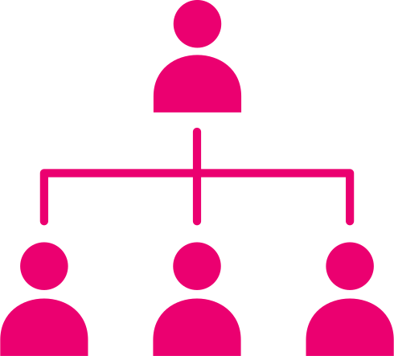
LARGE AUDIENCE
ACCESSIBILITY IS FOR EVERYONE
SPECIAL NEEDS
MOBILE USERS
SLOW
CONNECTION

Slide 4

BENEFITS EVERYONE
NOT JUST THE USERS, BUT ALSO THE AUTHOR
BETTER
A11Y
BETTER
SEO

Slide 5
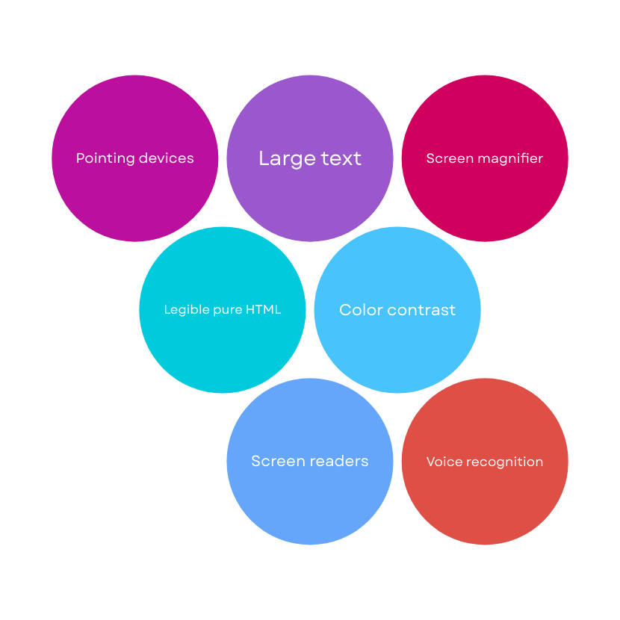
TECHNIQUES

Slide 6
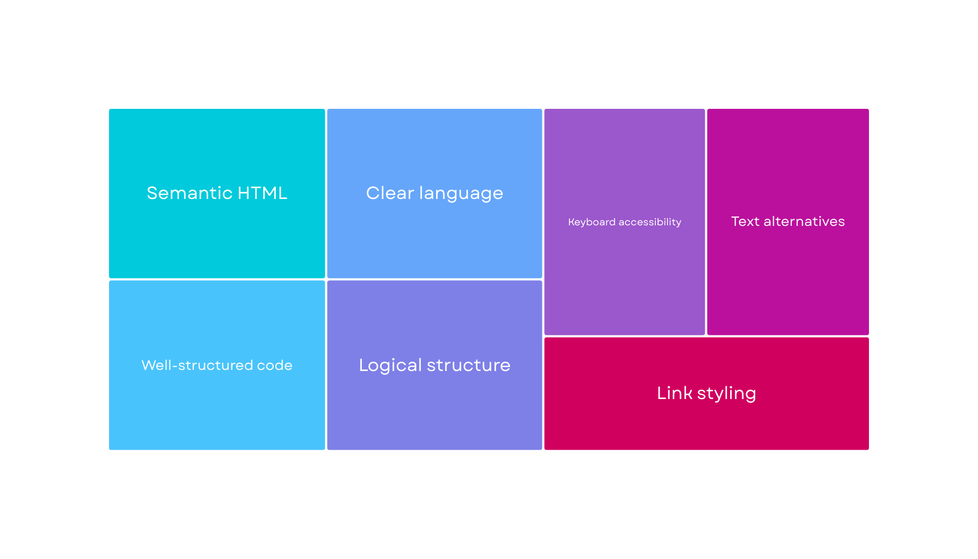
HTML & A11Y

Slide 7
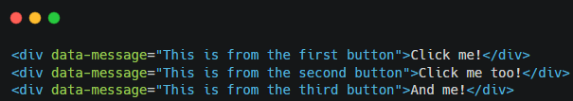
GOOD OR BAD?

Slide 8
THANK YOU

